Slide 1
Real-Time Event Processing
Ben Snively
Solutions Architect
Herndon, VA
November 10th, 2015

Slide 2
Agenda Overview
8:30 AM Welcome
8:45 AM Big Data in the Cloud
10:00 AM Break
10:15 AM Data Collection and Storage
11:30 AM Break
11:45 AM Real-time Event Processing
1:00 PM Lunch
1:30 PM HPC in the Cloud
2:45 PM Break
3:00 PM Processing and Analytics
4:15 PM Close

Slide 3
Primitive Patterns
Collect
Process
Analyze
Store
Data Collection
and Storage
Event
Processing
Data
Processing
Data
Analysis

Slide 4
Real-Time Event Processing
Reminder
Event-driven programming
Trigger action based on real-time input
Examples:
Proactively detect errors in logs and devices
Identify abnormal activity
Monitor performance SLAs
Notify when SLAs/performance drops below a threshold

Slide 5
Two main processing patterns
Stream processing (real time)
Real-time response to events in data streams
Relatively simple data computations (aggregates, filters, sliding window)
Micro-batching (near real time)
Near real-time operations on small batches of events in data streams
Standard processing and query engine for analysis

Slide 6
You’re likely already “streaming”
Sensor networks analytics
Network analytics
Log shipping and centralization
Click stream analysis
Gaming status
Hardware and software appliance metrics
…more…
Any proxy layer B organizing and passing data from A to C
A to B to C

Slide 7
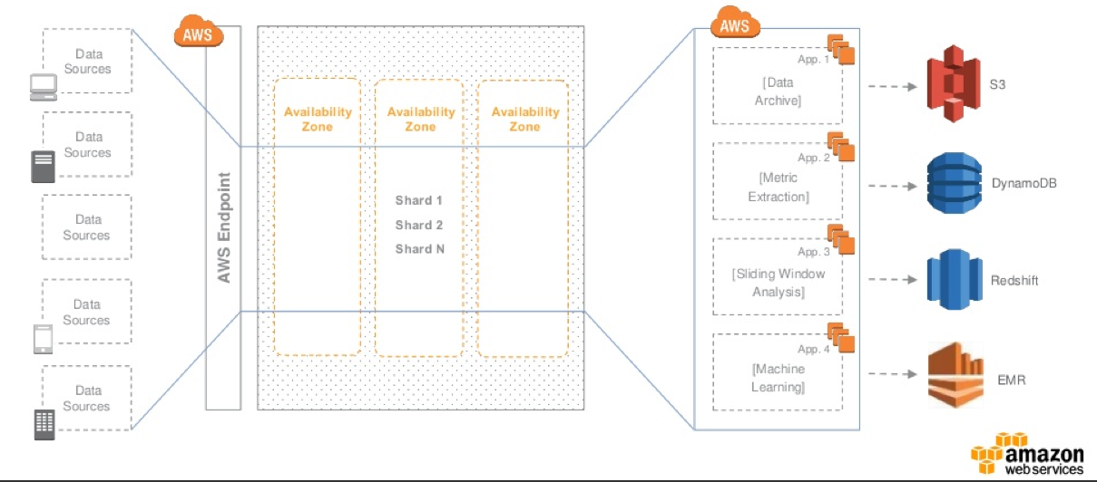
Amazon Kinesis
Kinesis Stream

Slide 8

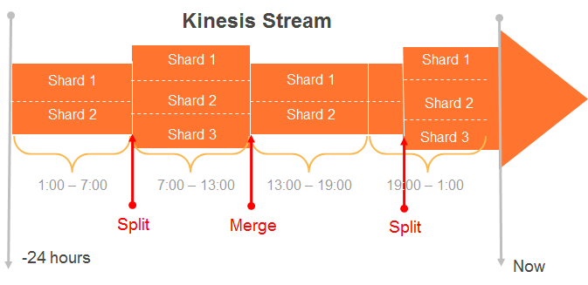
Kinesis Stream & Shards
Streams are made of Shards
Each Shard ingests data up to 1MB/sec, and up to 1000 TPS
Each Shard emits up to 2 MB/sec
All data is stored for 24 hours
Scale Kinesis streams by splitting or merging Shards
Replay data inside of 24Hr. Window
Extensible to up to 7 days

Slide 9
Why Stream Storage?
Decouple producers & consumers
Temporary buffer
Preserve client ordering
Streaming MapReduce
Producer 1
4 | 3 | 2 | 1
Key = Red
Amazon Kinesis
Consumer 1
Count of Red = 4
4 | 3 | 2 | 1
Key = Green
Shard or Partition 1
4 | 4 | 3 | 3 | 2 | 2 | 1 | 1
Producer 2
Count of Violet = 4
Key = Blue
Producer 3
4 | 3 | 2 | 1
Shard or Partition 2
4 | 4 | 3 | 3 | 2 | 2 | 1 | 1
Consumer 2
Key = Violet
Count of Blue = 4
Producer N
4 | 3 | 2 | 1
Count of Green = 4

Slide 10
How to Size your Kinesis Stream - Ingress
Suppose 2 Producers, each producing 2KB records at 500 KB/s:
Minimum Requirement: Ingress Capacity of 2 MB/s, Egress Capacity of 2MB/s
A theoretical minimum of 2 shards is required which will provide an ingress capacity of 2MB/s, and egress capacity 4 MB/s
2 KB * 500 TPS = 1000KB/s
1 MB/S
Shard
1 MB/S
Payment Processing Application
2 KB * 500 TPS = 1000KB/s
1 MB/S
Shard
1 MB/S
Producers
Theoretical Minimum of 2 Shards Required

Slide 11
How to Size your Kinesis Stream - Egress
Records are durably stored in Kinesis for 24 hours, allowing for multiple consuming applications to process the data
Let’s extend the same example to have 3 consuming applications:
If all applications are reading at the ingress rate of 1MB/s per shard, an aggregate read capacity of 6 MB/s is required, exceeding the shard’s egress limit of 4MB/s
Solution: Simple! Add another shard to the stream to spread the load
1 MB/S
Payment Processing Application
2 KB * 500 TPS = 1000KB/s
Shard
1 MB/S
Fraud Detection Application
2 KB * 500 TPS = 1000KB/s
Shard
Recommendation Engine Application
Producers
Egress Bottleneck

Slide 12
Putting Data into Kinesis
Simple Put interface to store data in Kinesis
Producers use PutRecord or PutRecords call to store data in a Stream.
PutRecord {Data, StreamName, PartitionKey}
A Partition Key is supplied by producer and used to distribute the PUTs across Shards
Kinesis MD5 hashes supplied partition key over the hash key range of a Shard
A unique Sequence # is returned to the Producer upon a successful call

Slide 13


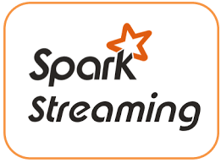
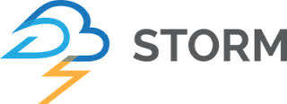
Real-time event processing frameworks
Kinesis
Client
Library
AWS Lambda

Slide 14
Use Case: IoT Sensors
Remotely determine what a device senses.

Slide 15

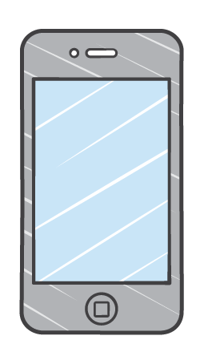
IoT Sensors - Trickles become a Stream
A
B
C
KCL
Small Thing
MQTT
Archive
Amazon
IoT
Persistent
Stream
Analysis
Lambda
HTTPS
Correlation
Mobile Device
Various Sensors

Slide 16


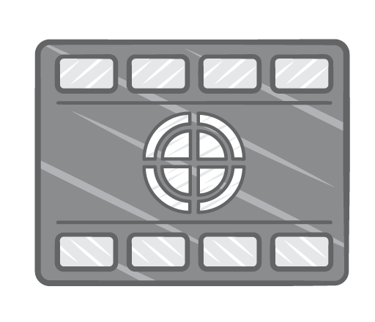
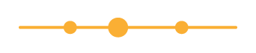
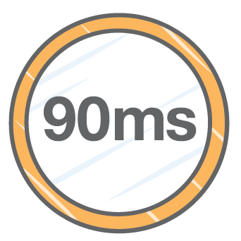
Use Case: Trending Top Activity

Slide 17





Ad Network Logging Top-10 Detail - KCL
Kinesis
Application
Data Record
Shard:
14
17
18
21
23
My top-10
Sequence Number
My top-10
Elastic Beanstalk
foo-analysis.com
My top-10
Global top-10
Data
Records
Kinesis
Stream
KCL Workers
Shard

Slide 18
Ad Network Logging Top-10 Detail - Lambda
Data Record
Shard:
14
17
18
21
23
My top-10
Sequence Number
My top-10
Elastic Beanstalk
foo-analysis.com
My top-10
Global top-10
Data
Records
Kinesis
Stream
LambdaWorkers
Shard

Slide 19
Amazon KCL Kinesis Client Library

Slide 20

Kinesis Client Library (KCL)
Distributed to handle multiple shards
Fault tolerant
Elastically adjust to shard count
Helps with distributed processing
Develop in Java, Python, Ruby, Node.js, .NET

Slide 21
KCL Design Components
Worker:- Processing unit that maps to each application instance
Record processor:- The processing unit that processes data from a shard of a Kinesis stream
Check-pointer: Keeps track of the records that have already been processed in a given shard
KCL restarts the processing of the shard at the last known processed record if a worker fails
KCL restarts the processing of the shard at the
last known processed record if a worker fails

Slide 22
Processing with Kinesis Client Library
Connects to the stream and enumerates the shards
Instantiates a record processor for every shard managed
Checkpoints processed records in Amazon DynamoDB
Balances shard-worker associations when the worker instance count changes
Balances shard-worker associations when shards are split or merged

Slide 23
Best practices for KCL applications
Leverage EC2 Auto Scaling Groups for your KCL Application
Move Data from an Amazon Kinesis stream to S3 for long-term persistence
Use either Firehose or Build an “archiver” consumer application
Leverage durable storage like DynamoDB or S3 for processed data prior to check-pointing
Duplicates: Ensure the authoritative data repository is resilient to duplicates
Idempotent processing: Build a deterministic/repeatable system that can achieve idempotence processing through check-pointing

Slide 24
Amazon Kinesis connector application
Connector Pipeline
Incoming Records
Transformed
Filtered
Buffered
Outgoing to Endpoints
Emitted

Slide 25
Amazon Kinesis Connector
Amazon S3
Batch Write Files for Archive into S3
Sequence Based File Naming
Amazon Redshift
Micro-batching load to Redshift with manifest support
User Defined message transformers
Amazon DynamoDB
BatchPut append to table
User defined message transformers
Elasticsearch
Put to Elasticsearch cluster
User defined message transforms
Kinesis
S3
Dynamo DB
Redshift

Slide 26
AWS Lambda

Slide 27
Event-Driven Compute in the Cloud
Lambda functions: Stateless, request-driven code execution
Triggered by events in other services:
PUT to an Amazon S3 bucket
Write to an Amazon DynamoDB table
Record in an Amazon Kinesis stream
Makes it easy to…
Transform data as it reaches the cloud
Perform data-driven auditing, analysis, and notification
Kick off workflows

Slide 28

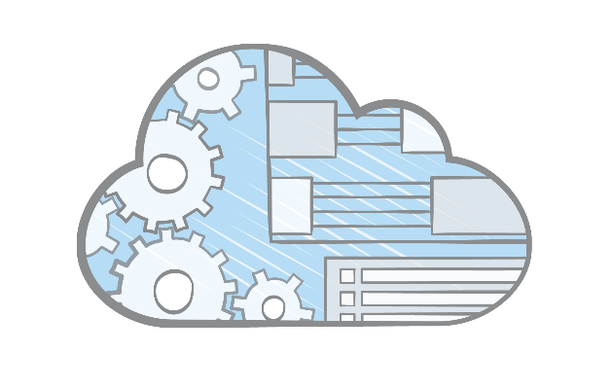
No Infrastructure to Manage
Focus on business logic, not infrastructure
Upload your code; AWS Lambda handles:
Capacity
Scaling
Deployment
Monitoring
Logging
Web service front end
Security patching

Slide 29
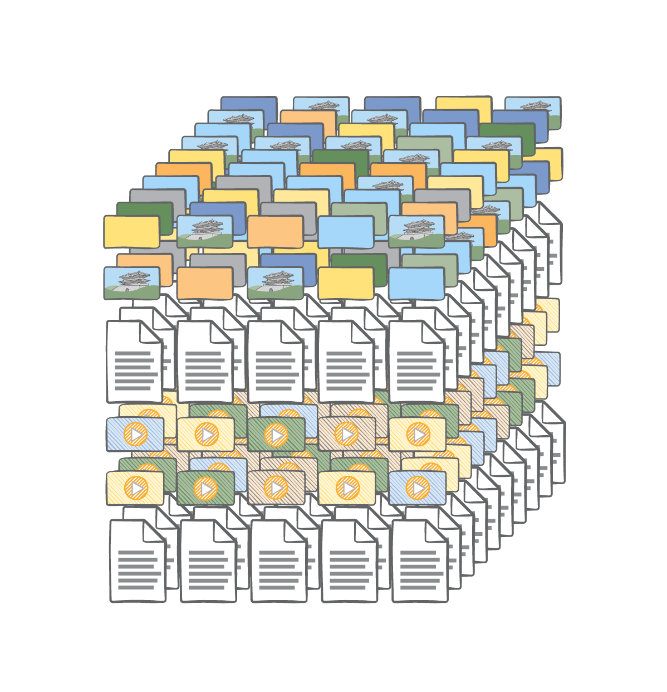
Automatic Scaling
Lambda scales to match the event rate
Don’t worry about over or under provisioning
Pay only for what you use
New app or successful app, Lambda matches your scale

Slide 30
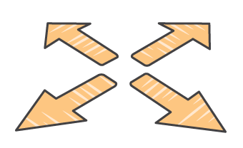
Bring your own code
Create threads and processes, run batch scripts or other executables, and read/write files in /tmp
Include any library with your Lambda
function code, even native libraries.

Slide 31
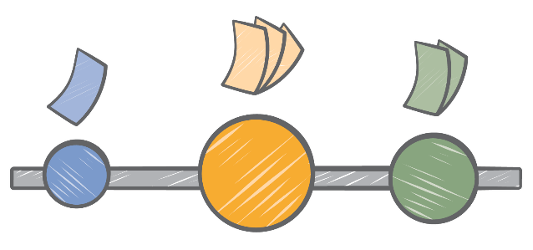
Fine-grained pricing
Buy compute time in 100ms increments
Low request charge
No hourly, daily, or monthly minimums
No per-device fees
Never pay for idle
Free Tier
1M requests and 400,000 GB-s of compute
Every month, every customer

Slide 32

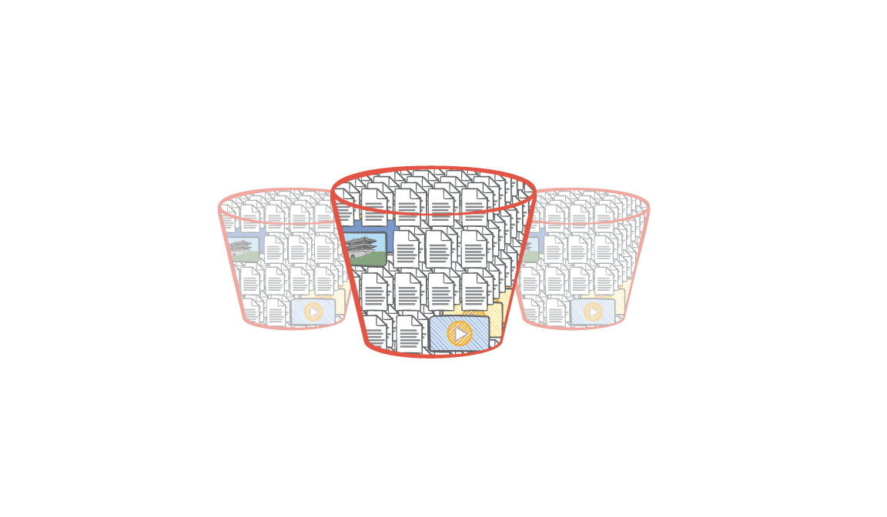
Data Triggers: Amazon S3
Satelitte image
Thumbnail of Satellite image
1
3
2
Amazon S3 Bucket Events
AWS Lambda

Slide 33
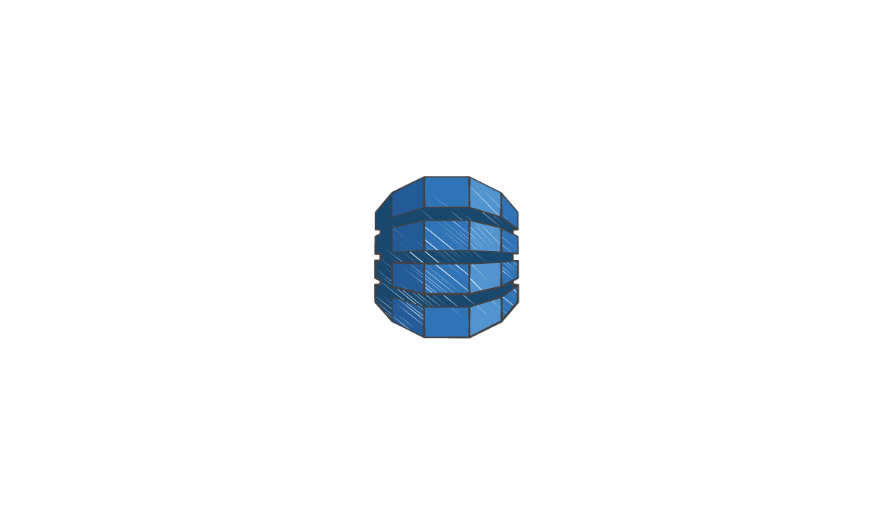
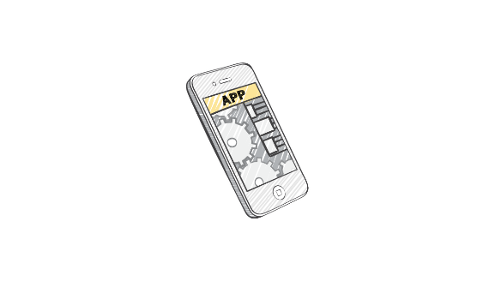
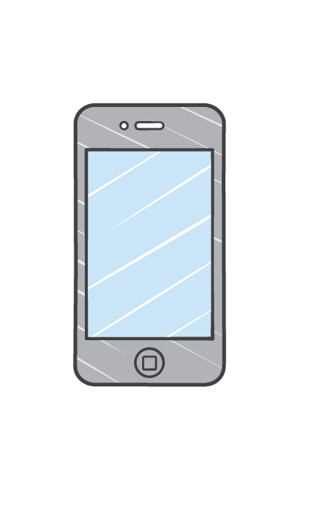
Data Triggers: Amazon DynamoDB
Update another table
Amazon DynamoDB
Table and Stream
AWS Lambda
Send Amazon SNS notifications

Slide 34
Calling Lambda Functions
Call from mobile or web apps
Wait for a response or send an event and continue
AWS SDK, AWS Mobile SDK, REST API, CLI
Send events from Amazon S3 or SNS:
One event per Lambda invocation, 3 attempts
Process DynamoDB changes or Amazon Kinesis records as events:
Ordered model with multiple records per event
Unlimited retries (until data expires)

Slide 35
Writing Lambda Functions
The Basics
Stock Node.js, Java, Python
AWS SDK comes built in and ready to use
Lambda handles inbound traffic
Stateless
Use S3, DynamoDB, or other Internet storage for persistent data
Don’t expect affinity to the infrastructure (you can’t “log in to the box”)
Familiar
Use processes, threads, /tmp, sockets, …
Bring your own libraries, even native ones

Slide 36
How can you use these features?
“I want to send customized messages to different users”
SNS + Lambda
“I want to send an offer when a user runs out of lives in my game”
Amazon Cognito + Lambda + SNS
“I want to transform the records in a click stream or an IoT data stream”
Amazon Kinesis + Lambda

Slide 37
Stream Processing Apache Spark Apache Storm Amazon EMR

Slide 38
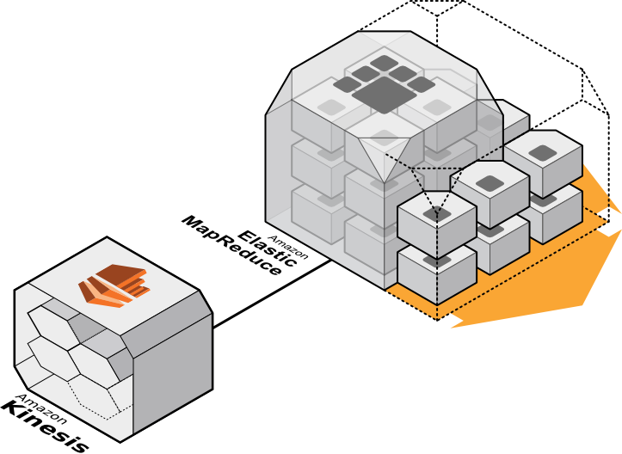
Amazon EMR integration
Read Data Directly into Hive, Pig, Streaming and Cascading
Real time sources into Batch
Oriented Systems
Multi-Application Support
and Check-pointing

Slide 39
Amazon EMR integration: Hive
CREATE TABLE call_data_records (
start_time bigint,
end_time bigint,
phone_number STRING,
carrier STRING,
recorded_duration bigint,
calculated_duration bigint,
lat double,
long double
)
ROW FORMAT DELIMITED
FIELDS TERMINATED BY ","
STORED BY
'com.amazon.emr.kinesis.hive.KinesisStorageHandler'
TBLPROPERTIES("kinesis.stream.name"=”MyTestStream");

Slide 40
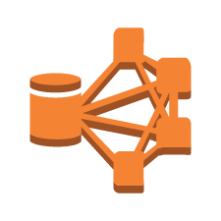
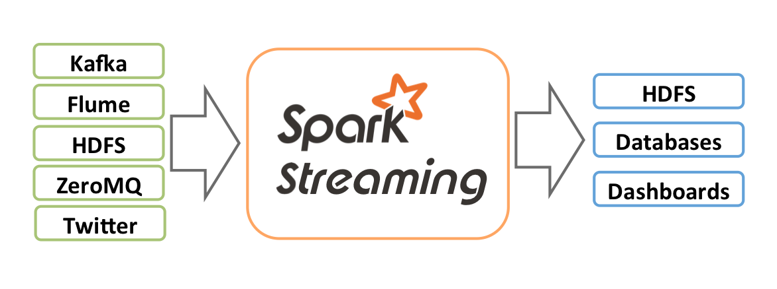
Processing Amazon Kinesis streams
Amazon
Kinesis
EMR with
Spark Streaming

Slide 41
Spark Streaming – Basic concepts
Higher level abstraction called Discretized Streams of DStreams
Represented as a sequence of Resilient Distributed Datasets (RDDs)
DStream
Receiver
RDD@T1
RDD@T2
Messages
http://spark.apache.org/docs/latest/streaming-kinesis-integration.html

Slide 42
Apache Spark Streaming
Window based transformations
countByWindow, countByValueAndWindow etc.
Scalability
Partition input stream
Each receiver can be run on separate worker
Fault tolerance
Write Ahead Log (WAL) support for Streaming
Stateful exactly-once semantics

Slide 43
Flexibility of running what you want
EC2/etc – wordsmith here

Slide 44
Apache Storm
Guaranteed data processing
Horizontal scalability
Fault-tolerance
Integration with queuing system
Higher level abstractions

Slide 45

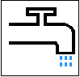
Apache Storm: Basic Concepts
Streams: Unbounded sequence of tuples
Spout: Source of Stream
Bolts :Processes input streams and output new streams
Topologies :Network of spouts and bolts
https://github.com/awslabs/kinesis-storm-spout

Slide 46
Storm architecture
Launches Workers
Worker Processes
Worker
Master Node
Cluster Coordination
Supervisor
Worker
Zookeeper
Supervisor
Nimbus
Zookeeper
Supervisor
Worker
Zookeeper
Supervisor
Worker

Slide 47



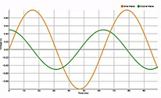
Real-time: Event-based processing
Kinesis
Storm
Spout
Producer
ElastiCache
(Redis)
Amazon
Kinesis
Node.js
Client
(D3)
Apache Storm
http://blogs.aws.amazon.com/bigdata/post/Tx36LYSCY2R0A9B/Implement-a-Real-time-Sliding-Window-Application-Using-Amazon-Kinesis-and-Apache

Slide 48
You’re likely already “streaming”
Embrace “stream thinking”
Event Processing tools are available that will help increase your solutions’ functionality, availability and durability

Slide 49
Thank You Questions?

